Slide 1
Critical Examination of Adult Special Education
Dr. Teresa Swan
May 5, 2022

Slide 2
Why am I here?
Research that explored the lives of students attending adult special education (ASE) and their experiences of oppression as well as the ways this study influences my thinking as an educator and researcher.
Dissertation Title: “I was planning on going to actual real school rather than a program like this”; Students with intellectual disabilities informing adult special education.

Slide 3
My Story
Higher Education
Diploma, Therapeutic Recreation
BA, Adult Education
PhD & MEd, Community Rehabilitation & Disability Studies
Employment
KPU, Adult Special Education
VIU, Educational Assistant & Community Support
Research
Post-secondary education (PSE) & students with the label of intellectual disabilities (ID)

Slide 4
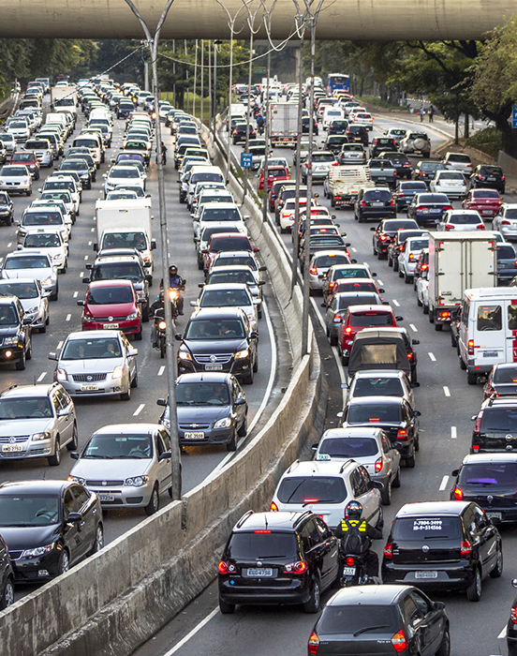
Unconscious Assumptions
Mental Health
Health Care
Community Recreation
Post-secondary Education
Adult Special Education

Slide 5
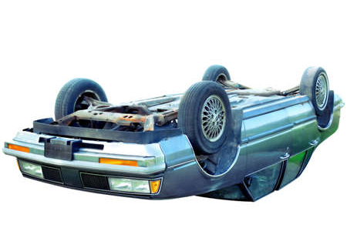
How theories intersected, contradicted & opposed each other
Adult Education
Adult Special Education
Social Model
Inclusive post-secondary education
Critical Disability Theory

Slide 6
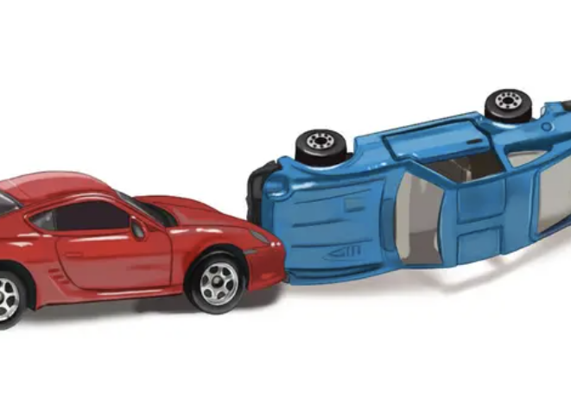
Tensions & Frustrations
Conversations with students & families that spoke out about ASE
Scholarship that emphasized ableism as an interpretive framework
ASE Practices – acts of violence
Ways students experienced inequities and injustices
Ways institutions contributed to student “othering”

Slide 7
ASE as harmful and outdated
Pedagogy as Disciplinary Mechanism
Excluded
Controlled
Curriculum of control
Falseness of Claims
Access
Inclusion
Employment
Independence

Slide 8
Asked myself…
Why are ASE learners educated and treated differently than their peers?
Why are many PSE options for students with label of ID segregated and focused solely on employment skills?
What academic disciplines inform ASE?
Why do adult education principles not apply in ASE?
Why is grooming and hygiene skills an admission requirement for some ASE programs?

Slide 9
Things changed: Reality Understanding Language
Shifted thinking about knowledge, who can create it, and who has the privilege, status, and power to govern it
Recognized and confronted ways that I, and others, embodied ableist messages, beliefs, & practices
Imagined possibilities of adding voices of students with ID to the academic scholarship
Questioned the role of power and knowledge in policies and practices that privileged some students over others

Slide 11
Research Design: Critical Ethnography
Primary Question: How are student’s academic and social activities socially organized by knowledge and power.
AIM: Learn more about the experiences of students in ASE and disrupt taken-for-granted practice
Positionality: dominate, privileged, white middle-class, “insider”
Data Collection: focus groups, observations, interviews, documents, reflective journaling
Sampling and recruitment, ethical considerations, study rigor, reciprocity

Slide 12
Theoretical Framework: Critical Disability Theory
Social Organization through text with Smith (1987, 1990)
Segregated and congregated
Remedial curriculum
Rigid admission process
Techniques of Discipline with Foucault (1977, 1982)
Control and manage
Punishment
Resistance
Infantize students

Slide 13
Themes: I asked students about…
Life as a University Student
Have you met friends outside of ASE?
Tell me what happens if you don’t follow the rules of ASE
Student Activities
Tell me what campus-wide activities you participate in
Benefits of Attending ASE
Tell me what you plan to do after ASE
How has your life improved attending ASE
Life after ASE
Tell me how ASE has prepared you for life after PSE
Have you found employment?

Slide 14
Interpretation of Findings
Revealed how ASE is embedded in deficit thinking and ways that practices are employed to mange, regulate, and control students against social norms.
My ethical and moral responsibilities as an educator.
The three overarching themes:
1) Bureaucratic Structure: Text and Disability
2) Deficit Text: Control and Compliance
3) Social Relations: Who Belongs Where?

Slide 15
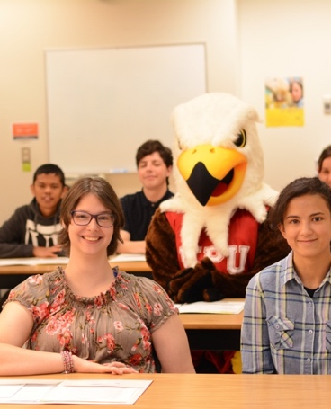
Summary of Findings
Deficit-based text
Images reinforce negative representation of students by contributing to their subjectivization as infantile, unproductive, dependent, and outcasts
Eugenics doctrine
Educational approaches used to observe and evaluate deviancy and “reduce” disability
Self-care and self-mastery of functional skills
Disciplinary tools
Sign-in sheets / Time-off request
Interactions of Resistance: Fear of Being Punished*
Students colonized to accept their label and characteristics associated with medical diagnosis, knowing their “place”

Slide 16
Making Obvious What Was Hidden
I Wanted A To Be A “Real Student” and This Is What They Told Me
PSE doesn’t value skills, abilities, knowledge of students, just be happy you are here because you don’t really belong, charity model
Us” and “Them”: ASE
Students “othered” by curriculum that disciplines students into conformity, legitimizing labeling, and scrutinizing their bodies,
“Kwinten” The Mascot: Rhetoric, Claims, and Tokenism
Tokenistic to appear accessible and inclusive, “doing good” work & serving community
The Exclude-able Student
Students have limitations and restrictions, limited and restricted access and participation
Teaching “In”dependence?
Artificial notion, assumes incompetence, remedial instruction emphasized on changing student body, student’s struggle to understand how evaluated and rely on instructor’s authority

Slide 17
My greatest learning…
Recognizing failure to deliver an education that recognizes student’s identity, competence, learning, human rights, or sense of belonging (human service day program)
My role in maintenance and reproduction of oppression and marginalization (commitment to PSE instead of to students)
Ways PSE naturalizes and justifies exclusion by creating a culture of charity – feel good, look good, done good
Students are capable and reliable research participants

Slide 18
Sped away, but didn’t get far
Resigned (from ASE)
Moved to VIU
Pandemic
Security and stability (rescinded resignation)
Leave of absence, program suspension
Conflict, struggle, discomfort
Back to VIU

Slide 19
Influences on my thinking today: The voices and experiences of students in the study are deeply embedded in my pedagogical approach to education and research.

Slide 20
No longer enchanted by the altruistic shiny new car – the next best model.
”Inclusive” Programs within structure of PSE
Success & failures of experimentation
Reproduction of inequalities
Promise of systemic change
Revision Work
Interdependence of ableism with other harmful social relations ( racism, sexism, colonialism)
Reduce harm and violence
Digital Platforms
Using eportfolios to expand access to campus

Slide 21
What I am thinking about today
Committed to making change, but it looks different
No need to “repair” adult special education because it is unrepairable and just lead to expansion of the existing system (with a new paint job possibly)
Learning about how higher education is interpreting other forms of systemic oppression
Reciprocity
Thinking about dichotomy of ‘inclusive” versus “segregated” debate
Co-op of language
Refuse engagement

Slide 22
Break Out Groups
I resonated with...
I was disappointed with…
I already knew…

