Slide 1
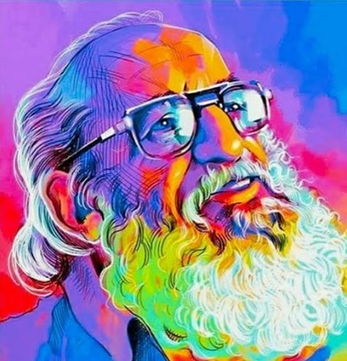
Education does not transform the world. Education changes People. People change the world.
Paulo Freire

Slide 2
Creating Spaces for Social Transformation: Paulo Freire and Inclusive Post-secondary Education
Mary Sweatman & Kenya Fithe
Notes:
This session will centre around Paulo Freire’s work and the role of the university/college as places of social transformation, which require all citizen’s to be valued and liberated through dialogue and praxis.

Slide 3
Agenda
Landing
Introduce Freire Concepts
Activity: Reimagining the Post- secondary experience
Share, debrief and commit

Slide 4
Paulo Freire 101
Critical consciousness (education for liberation, to become conscious of contradictions, inequities)
Collective Action in community, with community through dialogue and praxis (the oppressed and the oppressor)
Social transformation
Notes:
The process of awareness that begins as people start to question their everyday reality and make connections between their personal lives and the political structures of society that creates this reality
This must lead to collective action through empowering community (not just the individual, not just the oppressed – education leads to the oppressed regaining their humanity, and restoring the humanity of the oppressors –this leads to mutual discovery – new ways of knowing lead to the co-creation of new knowledge. Co-created knowledge comes through dialogue- mutual, respectful communication between people, engaging the heart and mind, the intellect and emotions. The roles of the educator and learner become mutual and interchangeable – everyone becomes a co-learner/co-teacher. Praxis is the unity of theory and practice that comes together in action and reflection
The work leads to a transformation of all society – this happens through collective action from local projects to movements for change through projects, campaigns, alliances and networks
Paulo Reglus Neves Freire was a Brazilian educator and philosopher who was a leading advocate of critical pedagogy. His influential work Pedagogy of the Oppressed is generally considered one of the foundational texts of the critical pedagogy movement,^{[37][38][39]} and was the third most cited book in the social sciences as of 2016 according to Google Scholar.^{[40]}

Slide 5
More on Freirean Dialogue:
Dialogue is the heart of critical consciousness (connecting the personal to the political)
It is a relational practice that requires mutual, respectful, reciprocal communication; engaging the heart and mind
It is an artful practice of relaxed, informal conversations that build empathy and trust in order to understand someone’s concerns
The facilitator/critical educator believes in people’s infinite potential, that everyone has gifts (assets)
Notes:
Connect to having good conversations today, but also with each other and students in the future:
Learning Conversations (from McKnight – Asset-based Community Development, which is born from Friere’s work):
All people care about something but…
• Care remains invisible without intentional conversations about what people care about.
• People may not care about what those with a particular agenda want them to care about.
• Care must be discovered through relationships that are built on purpose.
• Learning conversations are the way to make care visible. They are intentional, thoughtful conversations where people share and reflect on their gifts, passions and what they care about.

Slide 6
Dialogue cannot exist without humility.
Paulo Freire

Slide 7
Activity: Engage in Dialogue around Reimagining Inclusive Post Secondary Institutions
Consider:
How would we teach, how would we learn?
How would we govern?
How would the space be designed?
Would your role exist?
The Inclusive Post- secondary Education Benchmarks
Notes:
https://www.centre-ipse.org/uploads/6/2/0/8/62081869/2012_alberta_govt_-_measuring_quality_in_-_an_evaluation_tool_rev.pdf
Let’s go beyond reform, and imagine a transformed education system that is inclusive – that would support a diversity of learners that is liberating and democratizing, in ways that lead to collective action and social transformation.
Come to this conversation from your position of knowledge and power, to share your vision for a post-secondary education system.
For example, in my position as an associate professor: I can develop my course outlines using the principles of universal design for learning. This past year I have participated in book club with other faculty on ungrading practices.
Before the pandemic, teaching online to accommodate a student who couldn’t make it to class was unrealistic, but this past year I have taught seven different types of courses through a hybrid delivery system, and it worked. Proving that accommodating a student online, when they cannot get to class, is possible.

Slide 8
Before you go into groups:
Select a notetaker, who will report back
Suggestion: Select a host, who can help facilitate, share the space
20 minutes in dialogue
1 minutes for each group to report back on the generative themes from your dialogue (generate passion for change, and there is agreement)

Slide 9
Praxis – the unity of theory and practice, reflection and action
Critical reflection leads to informed action, and this is the only way to bring about sustainable change….
So, take a minute to consider what action you can take based on your group’s dialogue, or from something that you have reflected on over the past two days.
Commit to your action by typing it into the chat!

Slide 10
Thank You
Washing one’s hands of the conflict between the powerful and the powerless means to side with the powerful, not to be neutral….(therefore)…the educator has the duty of not being neutral and education is never neutral.
Paulo Freire

